Slide 1
FIN
“Your mobile device has quickly become the easiest portal into your digital self.”
A Friend In Need

Slide 2
TEAM MEMBERS
MD Zahidul Haque 180204136
Sanjida Aziz Tonny 180204122
S M Tasnimul Hasan 180204142
Fazle Elahi Safin 180204119
K H Rifat Amin 180204116

Slide 3

What is FIN ?
FIN is an emergency service based android application.

Slide 4
Purpose Behind Information Gathering & Survey
To make our App more realistic and user friendly
To add more important & realistic features
Understanding consumer’s need
To understand current market situation
Make it accessible to more people

Slide 5
Survey Analysis

Slide 6
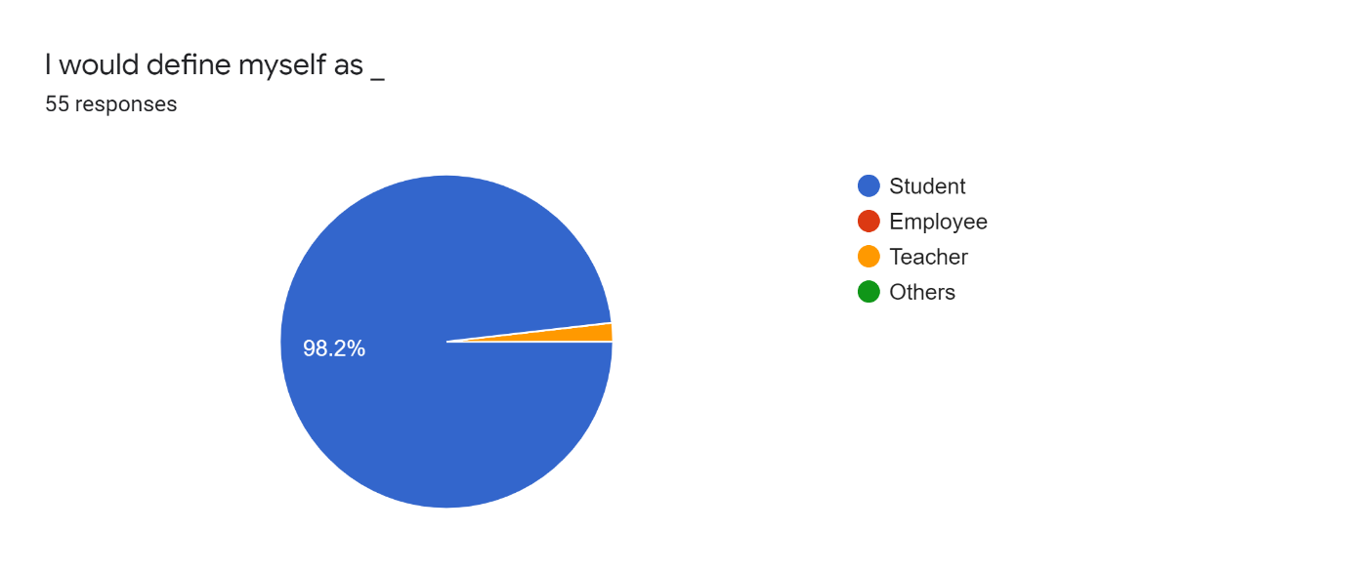
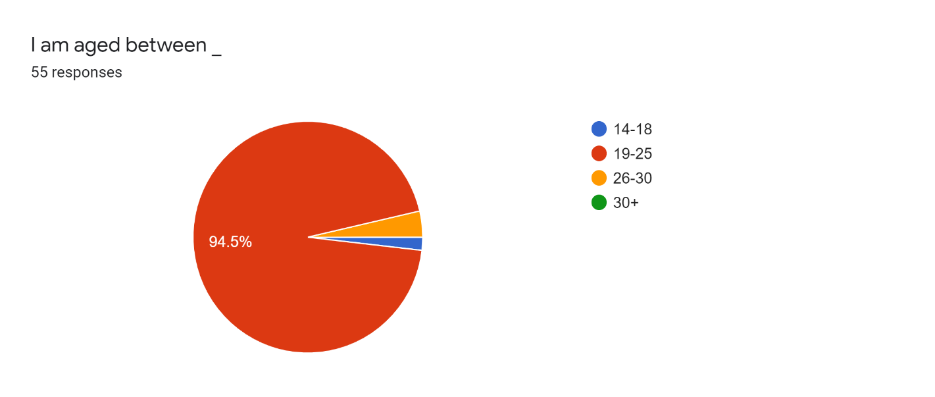
Participant's Occupation & Age
Most of them were Aged between 19 to 25 and most of them were Student

Slide 7
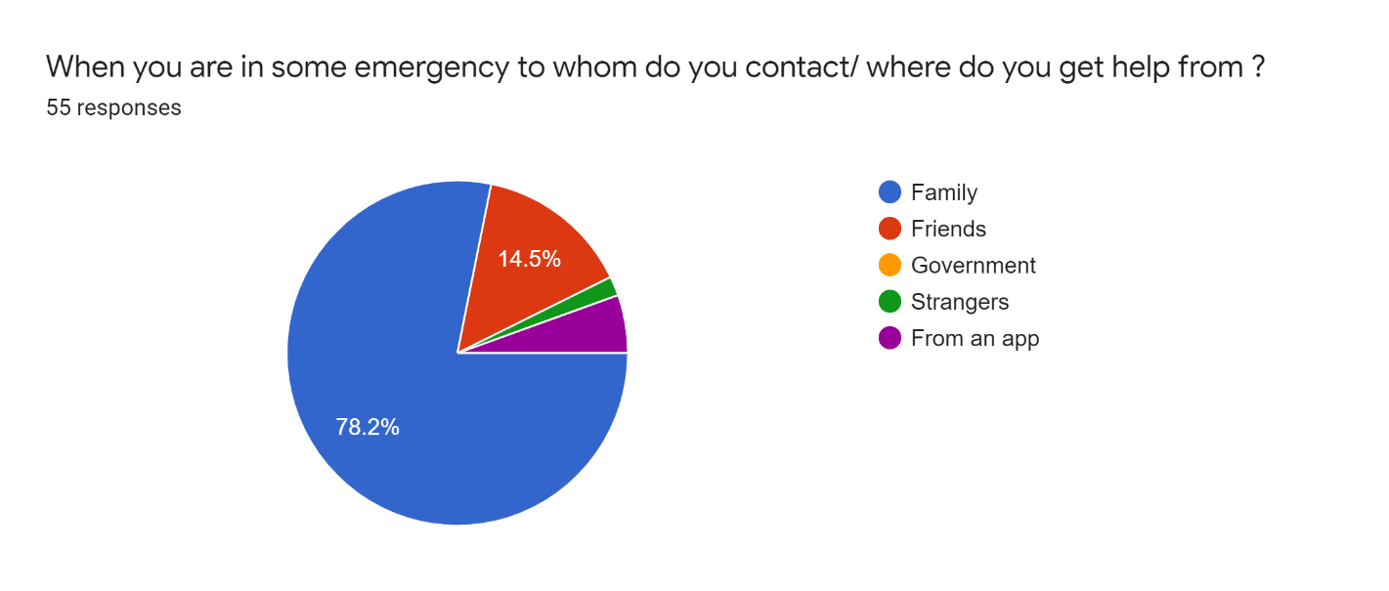
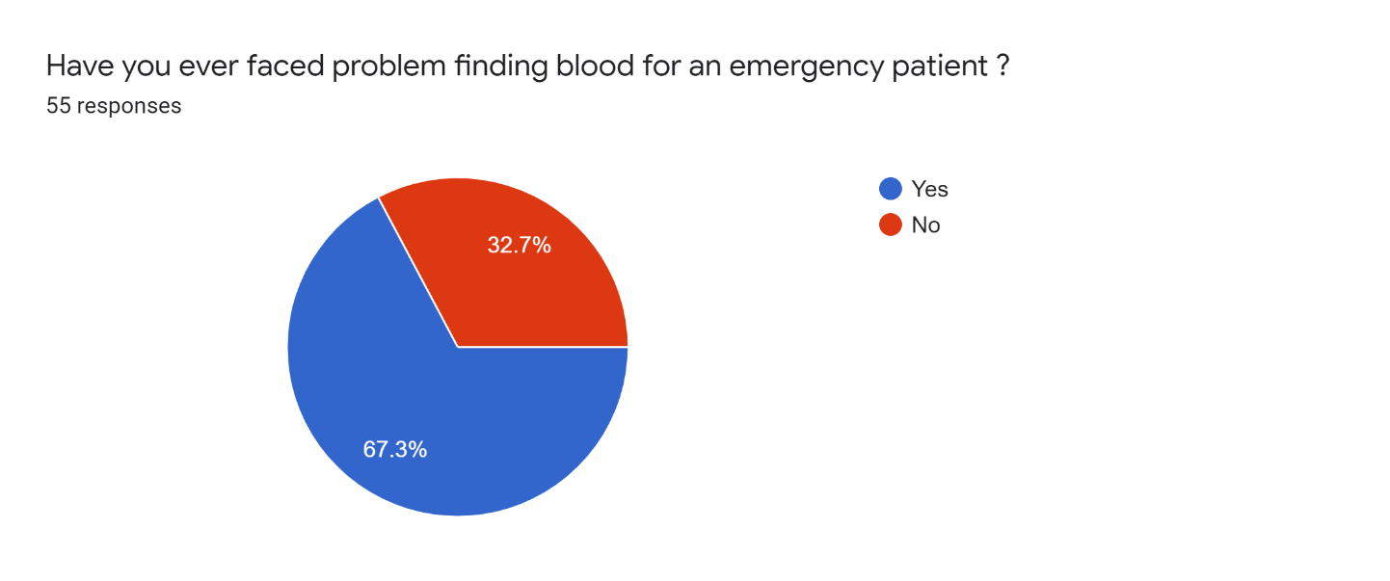
People tend to contact their family members during emergency
Around 70% people faced problem to find blood during crisis

Slide 8
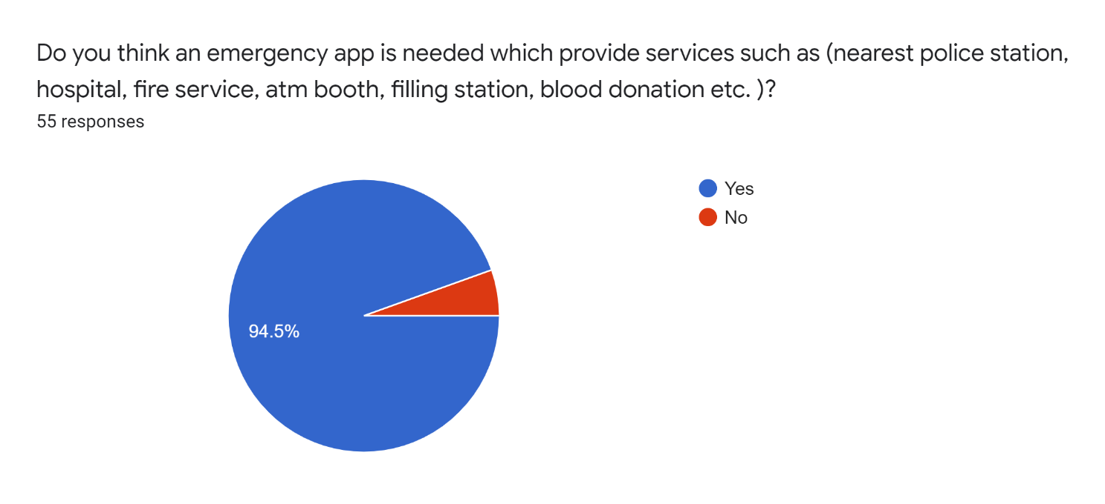
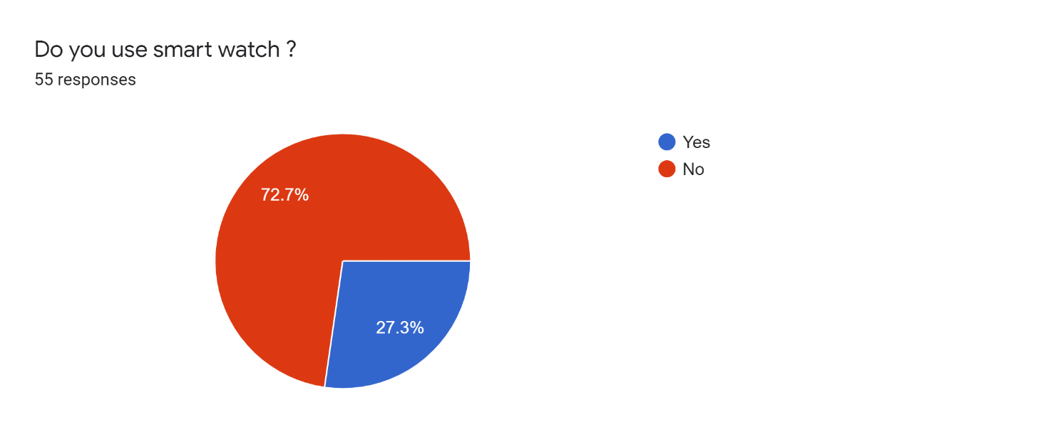
Almost everyone feels the need for such an App
Smart watch will help us to monitor heart rate and oxygen level during critical situation

Slide 9
Cost Benefit Analysis

Slide 10
Cost benefit Analysis
Suppose,
We have 10,000 BDT now.
If we make 30% profit over the year,
PV = Present Value (the principal that we have invested)
= 10,000 BDT,
r = rate = 30%, t = Time = 1 year.
Thus,
Future Value, FV = PV(1+r)^t
= 10,000(1+0.3)^1
= 13,000 BDT

Slide 11
Gantt Chart

Slide 12
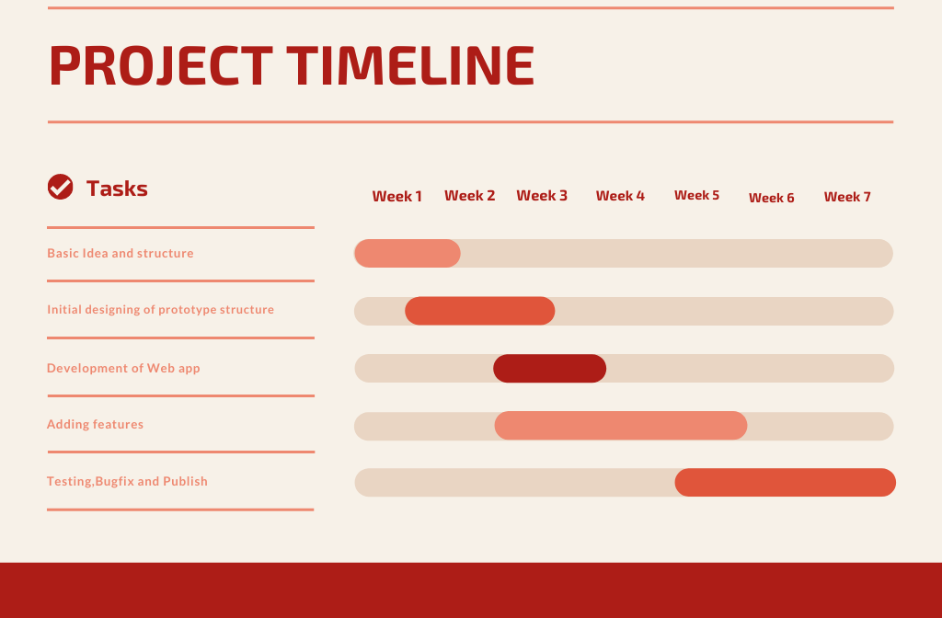
Weekly work schedule
We have around 5 tasks to complete within 7 weeks

Slide 13
Feasibility Study

Slide 14
Feasibility Study
Operational Feasibility : The data of users will remain secured throughout this application, the risk of data loss will be minimized.
2) Economical Feasibility : Developing this app needs low cost. So, the software is worth to develop considering the economical feasibility.

Slide 15
Feasibility Study
3) Technical Feasibility : This app will be available to run on almost all android device higher than android version 6.O
4) Legal Feasibility : At this time, there are no potential legal or copyright difficulties with our project.

Slide 16
Conclusion
A Friend in
need is a
friend indeed
Together we will make the world a safer place

Slide 17


